Slide 1
Unsupervised Learning

Slide 2
Review
Notes:
KNN??
NN??

Slide 3


Supervised Learning
Unsupervised Learning
Training set:
Training set:
Notes:
\{(x^{(1)},y^{(1)}),(x^{(2)},y^{(2)}),…,(x^{(m)},y^{(m)})\}
\{x^{(1)},x^{(2)},…,x^{(m)}\}

Slide 4
Today’s Outline
K-Means
Mixture Gaussian

Slide 5
K-Means
Notes:
finding a structure in a collection of unlabeled data.

Slide 6
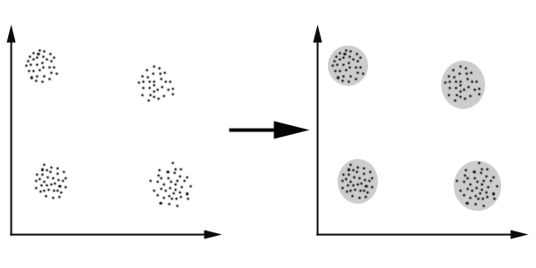
Clustering
Finding a structure in a collection of unlabeled data.
A cluster is a collection of objects which are “similar”

Slide 7
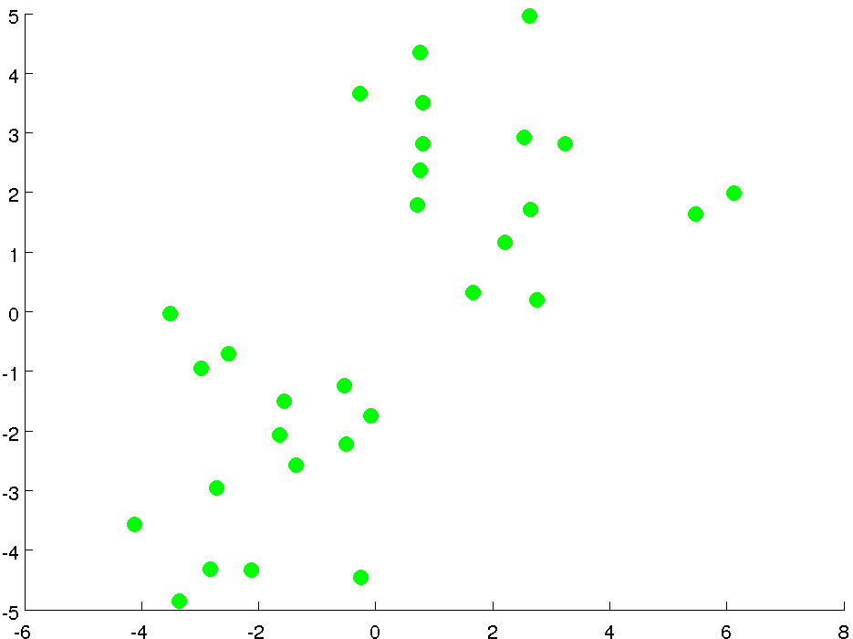
Notes:
TODO:调整图片尺寸

Slide 8
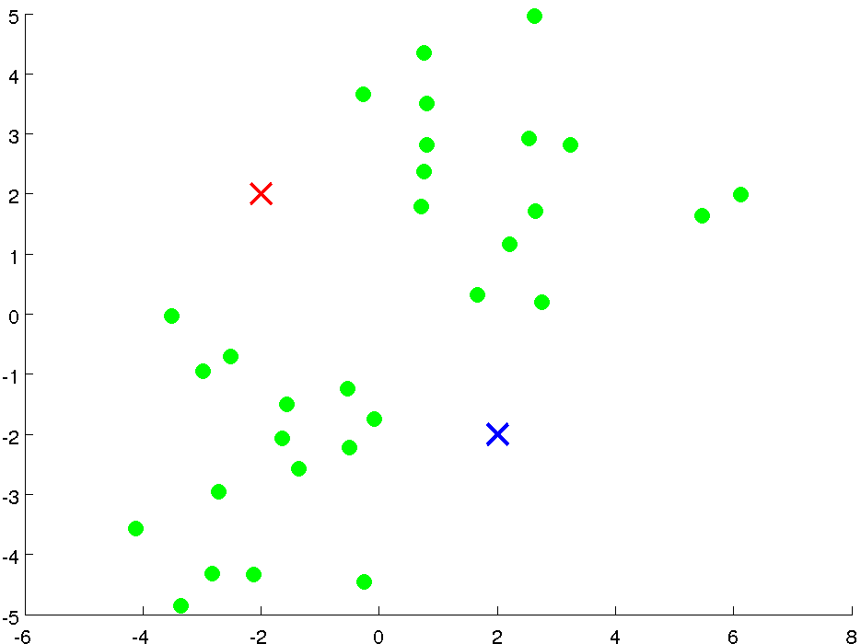

Slide 9
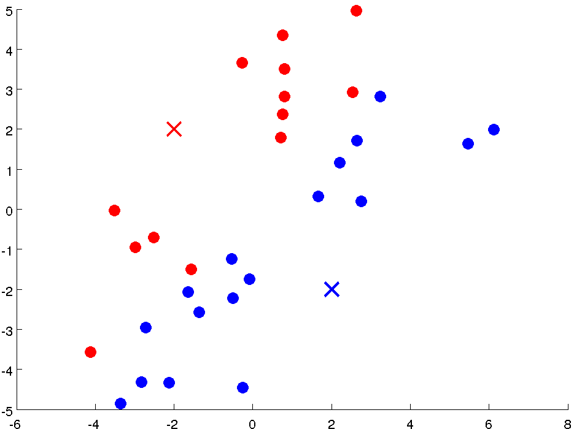

Slide 10
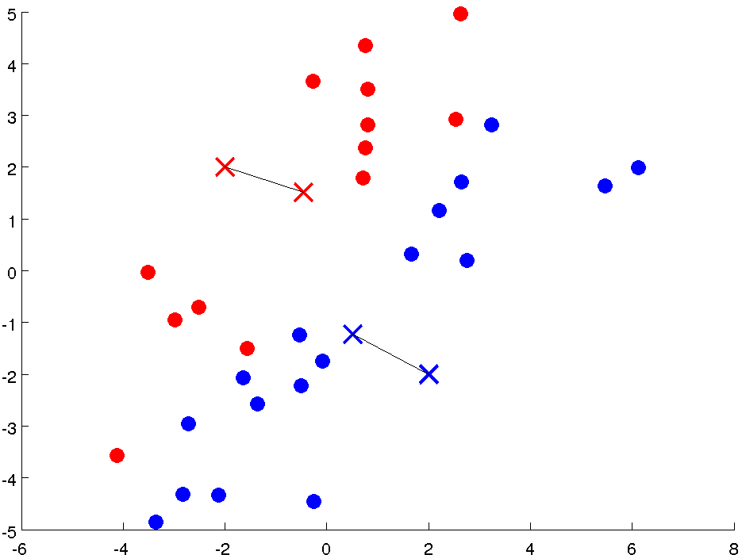

Slide 11
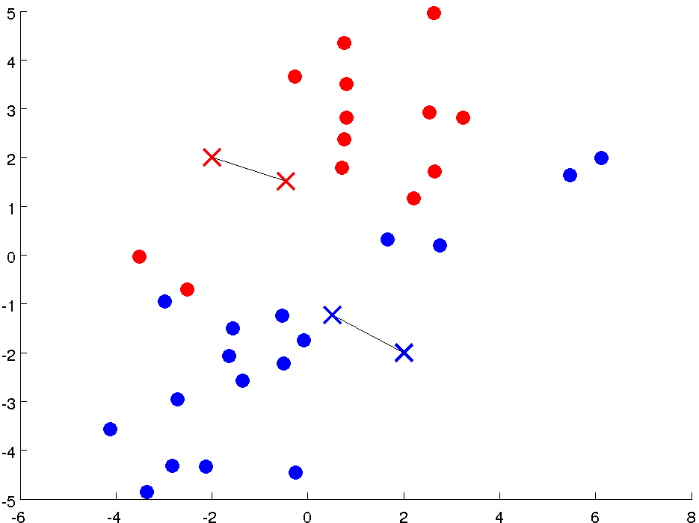

Slide 12
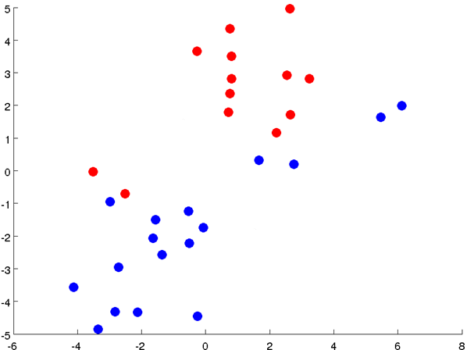

Slide 13
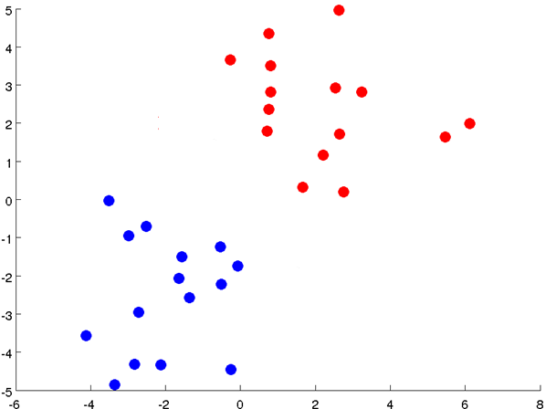

Slide 14
Notes:
Get rid of the legacy points

Slide 15
Notes:
Get rid of the legacy points

Slide 16
K-means Algorithm
Input: K, Training set
Algorithm:
Randomly initialize K cluster centroids
Notes:
TODO:
可以考虑从PRML上截图

Slide 17
K-means Algorithm
Input: K, Training set
Algorithm:
Randomly initialize K cluster centroids
Repeat:
for i = 1 to m
Index of cluster centroid closest to

Slide 18
K-means Algorithm
Input: K, Training set
Algorithm:
Randomly initialize K cluster centroids
Repeat:
for i = 1 to m
Index of cluster centroid closest to
for k = 1 to K
Average(mean) of points assigned to cluster k

Slide 19
K-means Algorithm
Input: K, Training set
Algorithm:
Randomly initialize K cluster centroids
Repeat:
for i = 1 to m
Index of cluster centroid closest to
for k = 1 to K
Average(mean) of points assigned to cluster k

Slide 20
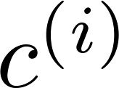

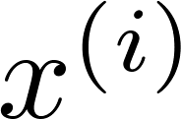

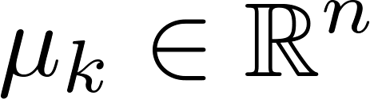

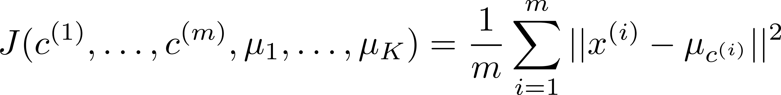
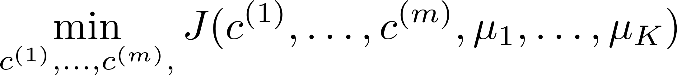

What’s K-means Optimizing?
= index of cluster (1,2,…, ) to which example is currently assigned
= cluster centroid ( )
= cluster centroid of cluster to which example has been assigned
Optimization objective:
Notes:
无监督学习同样也有优化目标

Slide 21
Will it be convergent?
Optimization objective:
Repeat:
for i = 1 to m
Fix
Minimize
Index of cluster centroid closest to
for k = 1 to K
Fix
Minimize
Average(mean) of points assigned to cluster k
Coordinate descent:
If J is bounded, it will convergent to a local optimum
Notes:
\min_{c}\min_{\mu}{J(c^{(1)},…,c^{(m)},\mu_1,…,\mu_k)}

Slide 22
Random initialization
Local optima
Notes:
解决这个的方案，有一些研究者提出了一些选择种子的方法，但是最简单的一种方法是我们用不同的初始值跑很多次，run kmeans，然后选择最后结果最好的

Slide 23
Applications
Marketing:
Finding groups of customers with similar behavior given a large database of customer data
Social network analysis:
Finding groups of users with similar interesting
Biology:
Classification of plants and animals given their features
Image segmentation and compression

Slide 24
Gaussian Mixture model

Slide 25
Gaussian distribution

Slide 26
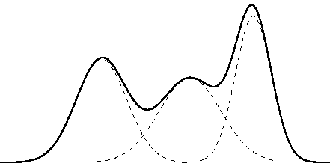
Mixture Gaussian
Density estimation
Data generated by 3 different Gaussian distribution
Which distribution one specific data point belongs to?
Soft assignment
Notes:
考虑一个density estimation的问题，我们观察到的数据呈现黑色实现这样子的分布，图中横轴表示一个样本的值，纵轴表示这个样本出现的概率。
发现他不能用我们一般学习到的概率分布，比如高斯分布、多项式分布、beta分布等等来表示
但是我们发现他可以用3个不同的高斯分布的和来表示（如虚线所示），那我们的密度估计只要学习出这三个高斯分布的均值与方差就行
这个问题下，我们还可以考虑这样一个问题，假设我们知道3个不同的高斯分布，我们用这样的3个分布随机的生成任意多个点，那么如何将某个点判定为属于哪一个分布?这就相当于一个聚类问题，如何将一个点分配到他应该属于的那个类中，和kmenas很像。只是这里是个软分类，

Slide 27
Data generation process
Training set is generated by:
1. Pick a cluster
2. Drawn from ‘s Gaussian
Density:
Notes:
\{x^{(1)},…,x^{(m)}\}
z^{(i)}\sim\text{Mulitnomial}(\phi)
(\phi_j\ge 0, \sum\nolimits_{j=1}^{k}{\phi_j}=1)
x^{(i)}
z^{(i)}
x^{(i)}|z^{(i)}=j~\sim~\mathcal{N}(\mu_j,\Sigma_j)
p(x^{(i)},z^{(i)})=p(x^{(i)}|z^{(i)})p(z^{(i)})

